Slide 1

Recommender Systems & Text mining
Szymon Łukasik
AGH University of Technology

Slide 2






What is a recommender system?
By a recommender system we understand a system which from a broad range of options presents the users only those who fit their needs.
Examples known from the Internet:

Slide 3
Sources of recommendation
Users - knowledge about users who’s the subject of recommendation – about demographics, location etc. but also their preferences (either by ranks or “favourites”) In addition to that: behavioral analysis.
Content – knowledge about options which can be offered (their properties, belonging to classes – e.g. genres)
Social relations – knowledge about other users, their relation with the tested user
Context – knowledge about external conditions at the time of recommendation (weather or time of the day are the classic examples)

Slide 4
Recommendation algoritms
Non-personalized
Content-based
Collaborative filtering

Slide 5
Non-personalized algorithms
Typically it involves:
Options popularity – suggest the most popular options (or the ones the most higly ranked). It gives the same result for any user.
Demographics – suggest options most popular among users belonging to the same demographic group
Linked options – suggest option most frequently selected with the one already chosen (e.g. “Good together” - Amazon and “Related videos” - Youtube)

Slide 6
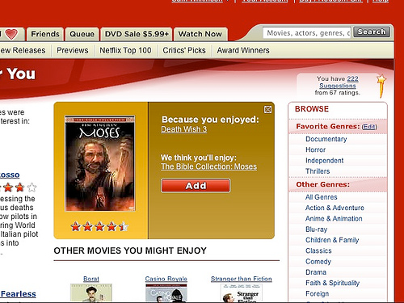
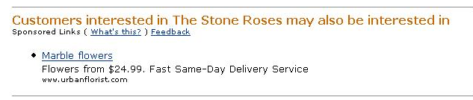
Content based
Recommend options which are the most similar to the ones aleady chosen by the user – uses sophisticated content-analysis or only categories (e.g. genres)

Slide 7
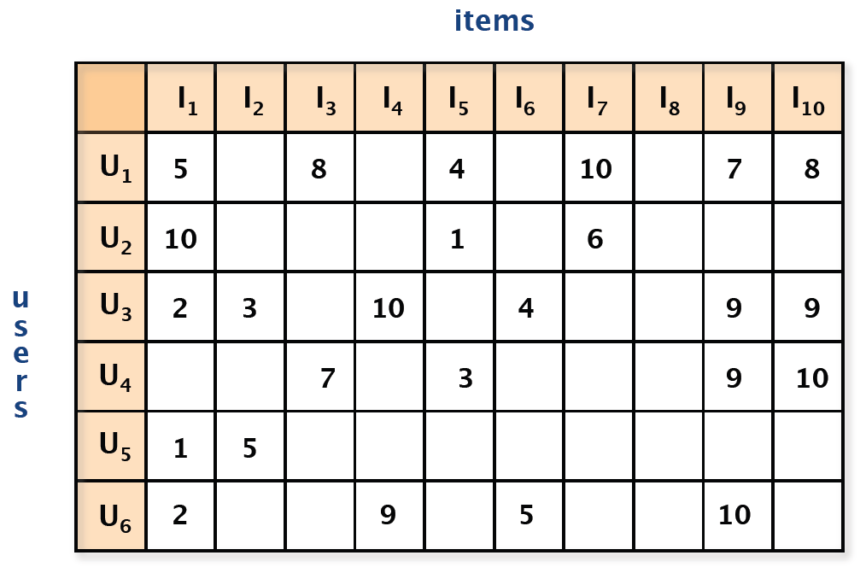
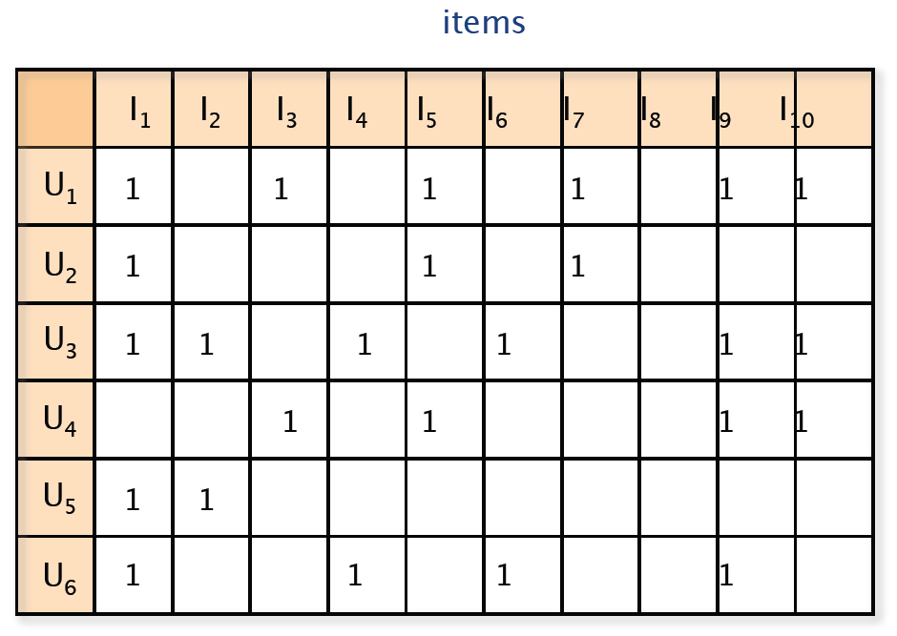

Collaborative filtering
Collaborative filtering was introduced for the first time at the beginning of 1990s. It describes a group of methods used to filter out unimportant information for selected users – using similar preferences.

Slide 8
User-based CF
 | Indiana Jones | LOTR | Seven | Brazil
Jack | 4 | ? | 5 | 5
Martin | 4 | 2 | 1
Anne | 3 |  | 2 | 4
Peter | 4 | 4
Natalie | 2 | 1 | 3 | 5
How to Judge if Lord of the Rings is suitable for Jack?

Slide 9
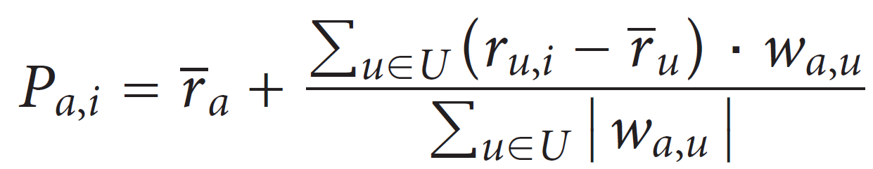
User-based CF
Calculate weights describing similarity of user to the other users (examples: Pearson correlation, cosine distance)
Select k clostest users, known as neighborhood (or pick all already evaluated this option).
Calculate preference level using neighbor notes:
P_{a,i} – expected recommendation level for user a and option i
r_{u,i} – preference of user u of option i
w_{a,u} –similarity of users a i u
U – set of users who evalueated option i

Slide 10
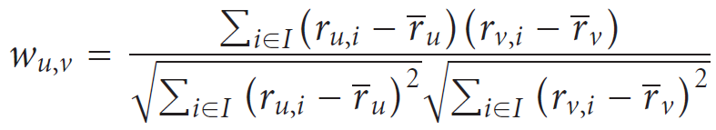
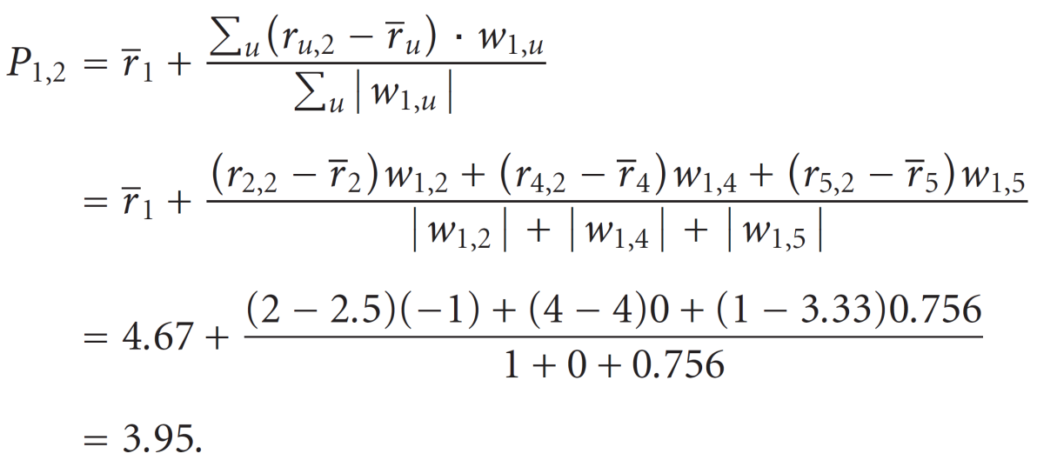
Example
 | Indiana Jones | LOTR | Seven | Brazil
Jack | 4 | ? | 5 | 5
Martin | 4 | 2 | 1
Anne | 3 |  | 2 | 4
Peter | 4 | 4
Natalie | 2 | 1 | 3 | 5
w_{1,2}=1
w_{1,4}=0
w_{1,5}=0,756

Slide 11
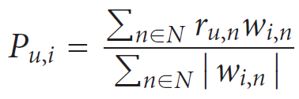
Item-based CF
Calculate weights describing similarity of option to the other options (examples: Pearson correlation, cosine distance)
Calculate preference level using neighboring notes:
P_{u,i} – expected recommendation for user u of option i
r_{u,n} – rating of option n for user u
w_{i,n} – similarity of option i and n
N – set of options evaluated by user u

Slide 12
Problems
Sparsity of recommendation matrix
No information about user/options preferences in the moment they appear in the matrix (so called cold-start)
Attacks on recommender systems (e.g. profile injection)

Slide 13
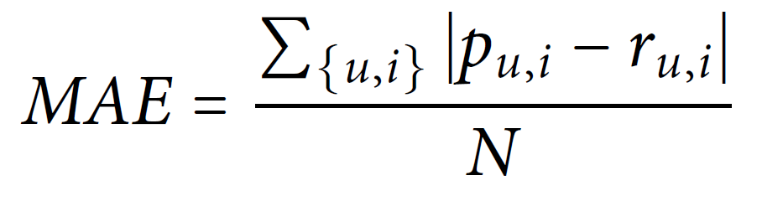
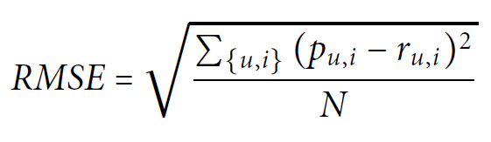
How to test recommender systems?
Divise a dataset into testing and training. Testing dataset represents recommendation to be done.
The error is calculated with Mean Absolute Error
or Root Mean Square:
Are you able to get rich with this one? http://www.netflixprize.com/

Slide 14
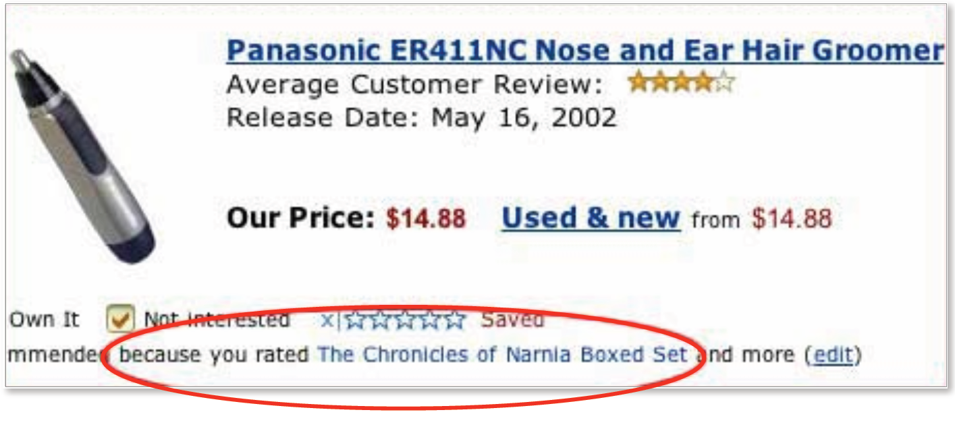
Does it work? In general…

Slide 15
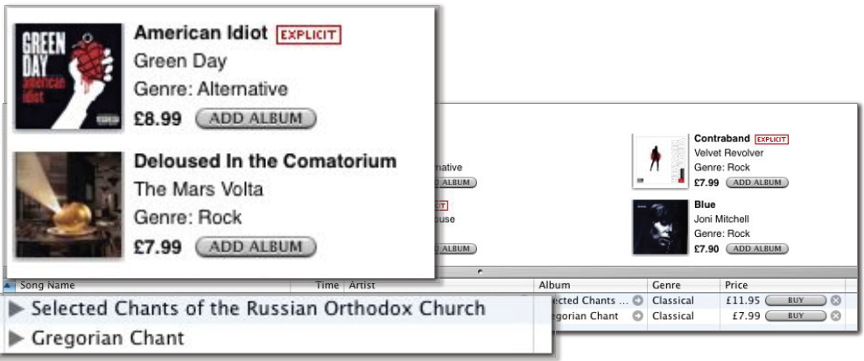
… in general

Slide 16
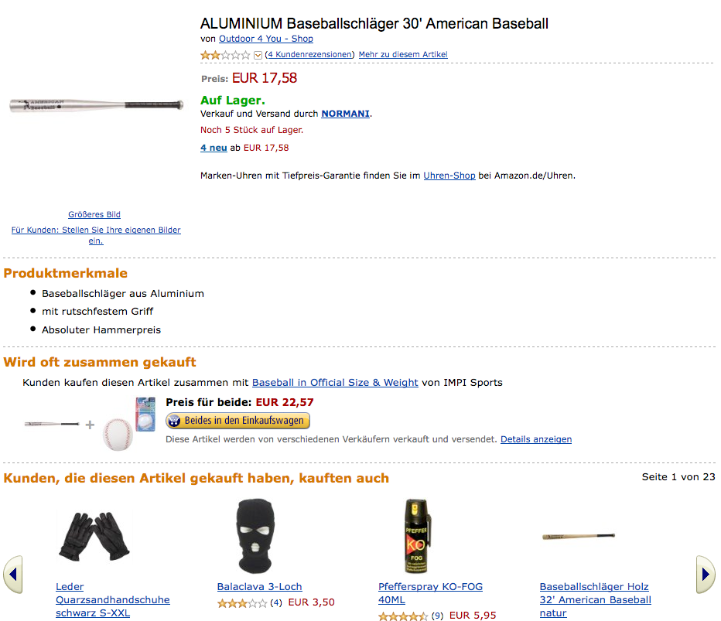
Sometimes it seems ok but….

Slide 17

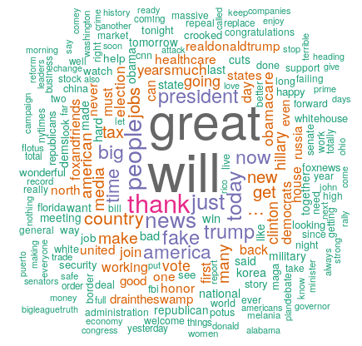
Text mining
Text mining, also called text data mining, roughly equivalent to text analysis, is the process of getting high-quality information from text.

Slide 18
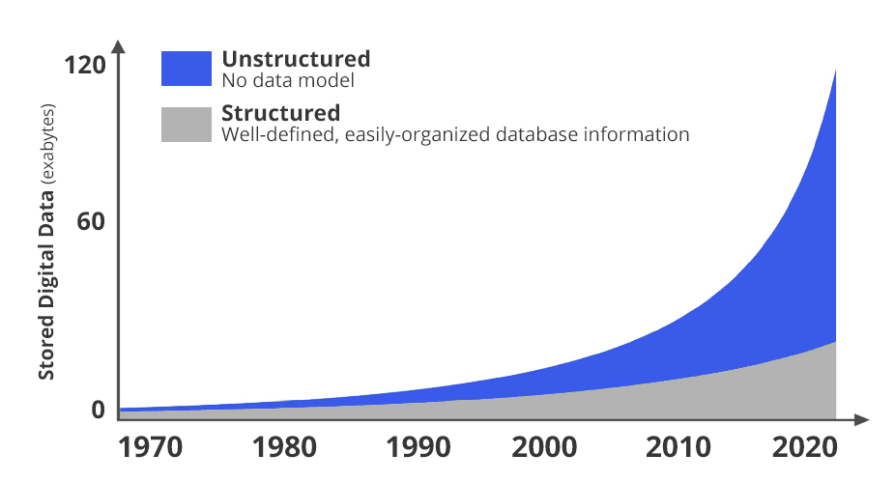
Why?
According to many studies (including Oracle) - the vast majority of data has an unstructured form (images, texts, videos, etc.).
http://idc.com

Slide 19
Sources of text data
websites
e-mail
medical records
customer surveys
incident reports
drug interaction reports
messages
less obvious: product descriptions, baskets, DNA sequences

Slide 20
Typical data mining problems
1. Analysis of single document
Information is obtained from the content of a single document, e.g. sentiment analysis, summaries generation.
2. Analysis of sets of documents
Extracting information is based on a collection of texts - e.g. by categorizing them, detecting non-standard texts, attribution, etc.

Slide 21
Quantitative document representation
Simplest representation – binary word incidence matrix
 | Chili | Chair | Mat | Mouse | Bike | Toy
D1 | 1 | 1 | 1 | 0 | 0 | 1
D2 | 1 | 1 | 1 | 0 | 1 | 0
D3 | 1 | 1 | 1 | 0 | 0 | 0
D4 | 1 | 1 | 1 | 0 | 0 | 0
D5 | 1 | 1 | 1 | 0 | 1 | 0
D6 | 1 | 0 | 0 | 1 | 1 | 1
D7 | 0 | 0 | 1 | 1 | 1 | 0
D8 | 1 | 0 | 0 | 1 | 1 | 1
D9 | 1 | 0 | 0 | 1 | 1 | 1
D10 | 1 | 0 | 0 | 1 | 1 | 1

Slide 22
Quantitative document representation
It can be extended to term frequency (TF), known also as bag-of-words.
 | Chili | Chair | Mat | Mouse | Bike | Toy
D1 | 24 | 21 | 9 | 0 | 0 | 3
D2 | 32 | 10 | 5 | 0 | 3 | 0
D3 | 12 | 16 | 5 | 0 | 0 | 0
D4 | 6 | 7 | 2 | 0 | 0 | 0
D5 | 43 | 31 | 20 | 0 | 3 | 0
D6 | 2 | 0 | 0 | 18 | 7 | 6
D7 | 0 | 0 | 1 | 32 | 12 | 0
D8 | 3 | 0 | 0 | 22 | 4 | 4
D9 | 1 | 0 | 0 | 34 | 27 | 25
D10 | 6 | 0 | 0 | 17 | 4 | 23

Slide 23
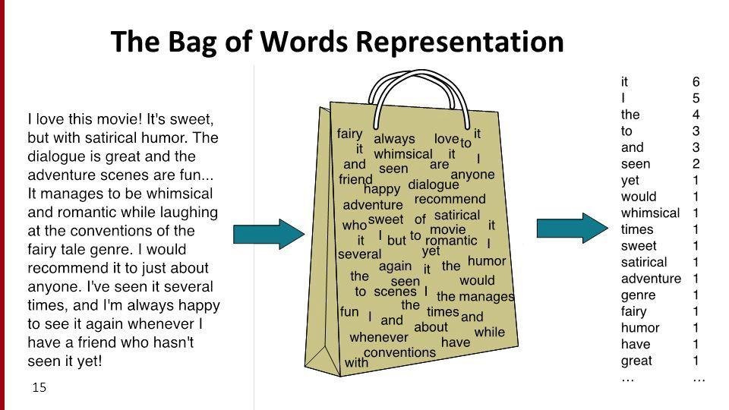
Bag of Words
https://www.programmersought.com/article/4304366575/

Slide 24
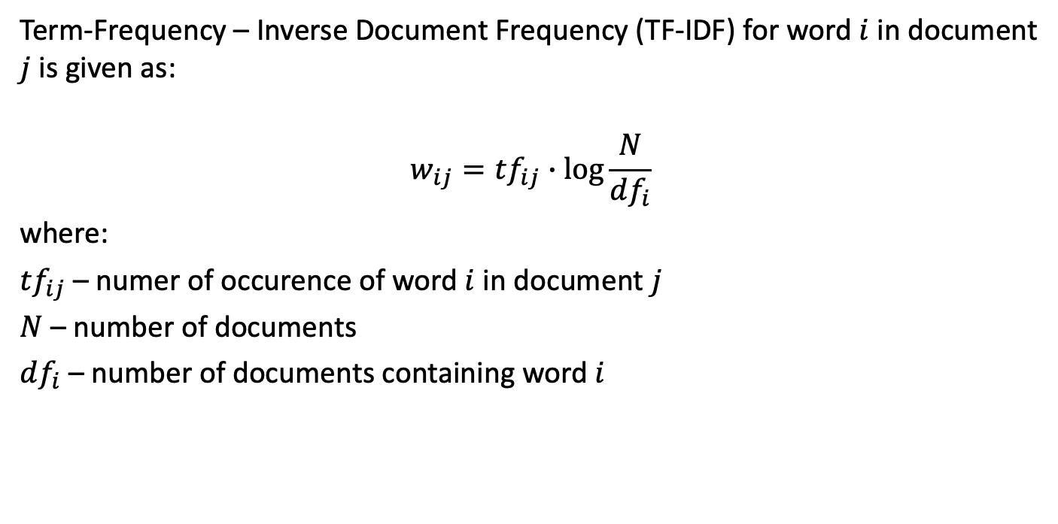
TF-IDF representation
Term-Frequency – Inverse Document Frequency (TF-IDF) for word $i$ in document $j$ is given as:
$$w_{ij}=tf_{ij}∙\log{\frac{N}{df_{i}}}$$
where:
$tf_{ij}$ – numer of occurence of word $i$ in document $j$
$N$ – number of documents
$df_{i}$ – number of documents containing word $i$

Slide 25
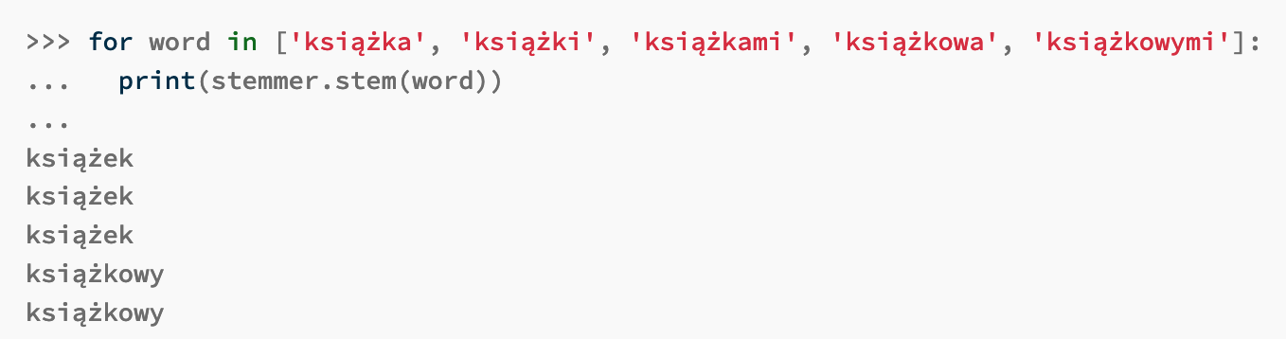
Data preprocessing
Deletion of punctuation marks from each processed document and creating, independently for each processed text, a list of words present in it
Removal of irrelevant words from the point of view of further analysis
Converting words appearing on lists to their basic form. The transformation to the base form is also known as the stemming. Usually implemented with the help of rules or with the use of dictionaries.
https://pypi.org/project/pystempel/

Slide 26
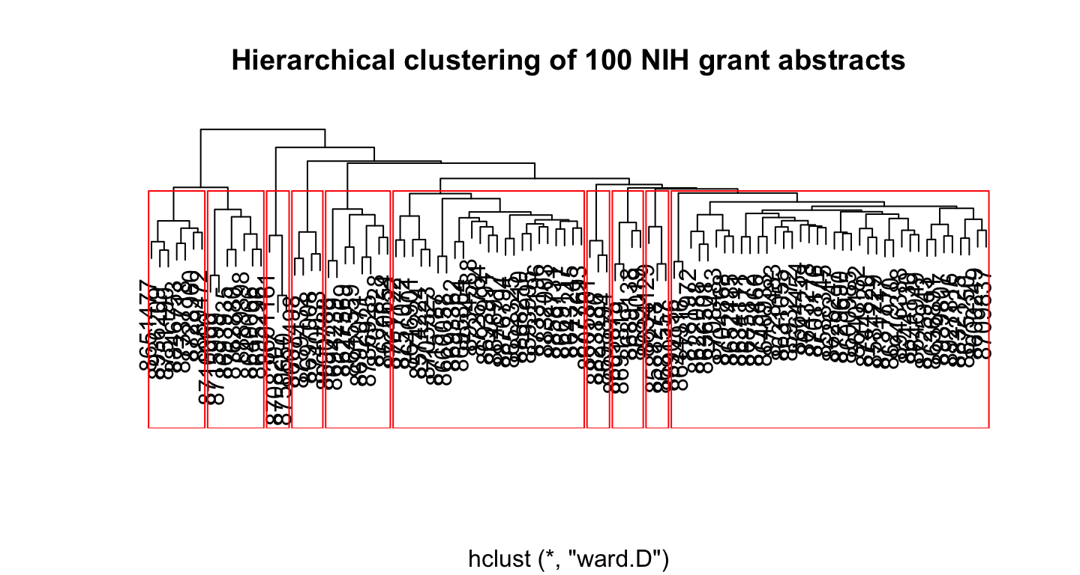
Example
https://www.rtextminer.com/articles/b_document_clustering.html

Slide 27
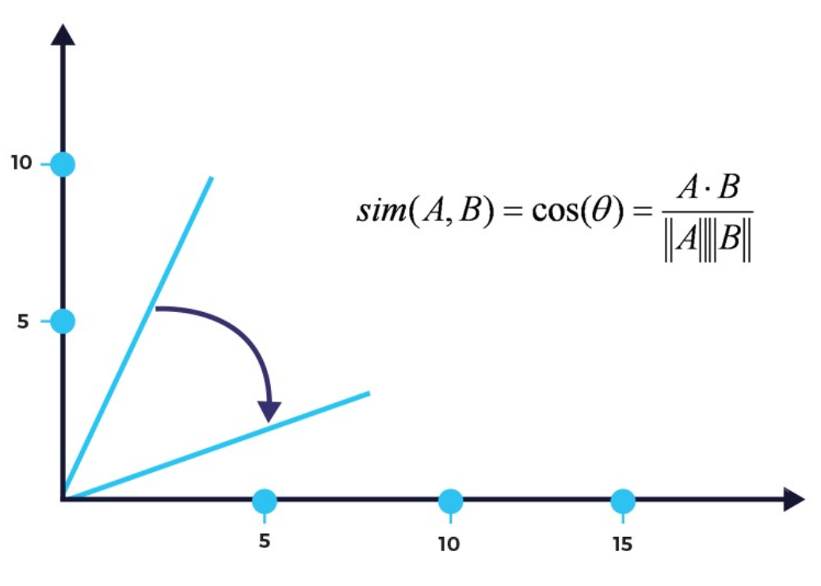
Similarity?
https://intellica.ai/

Slide 28
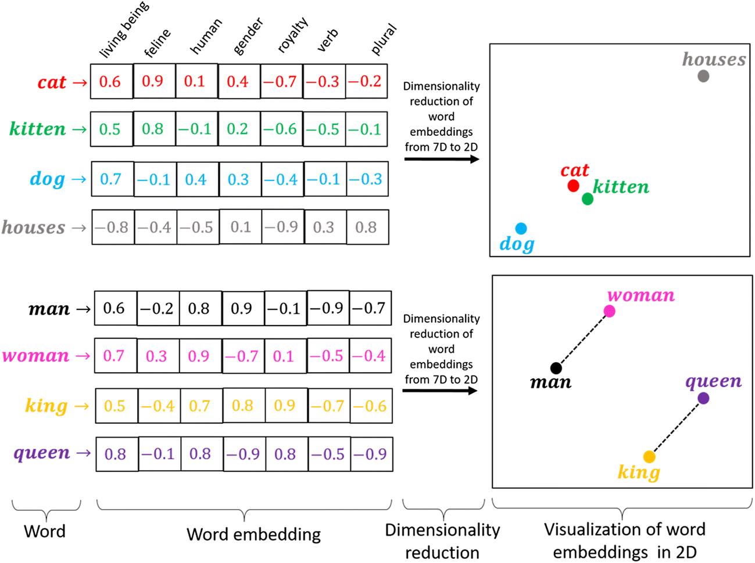
Word embeddings

Slide 29
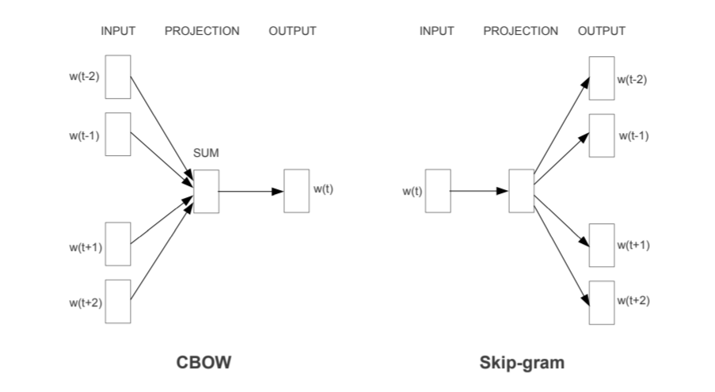
Word embeddings
In practice? First model – word2vec

Slide 30
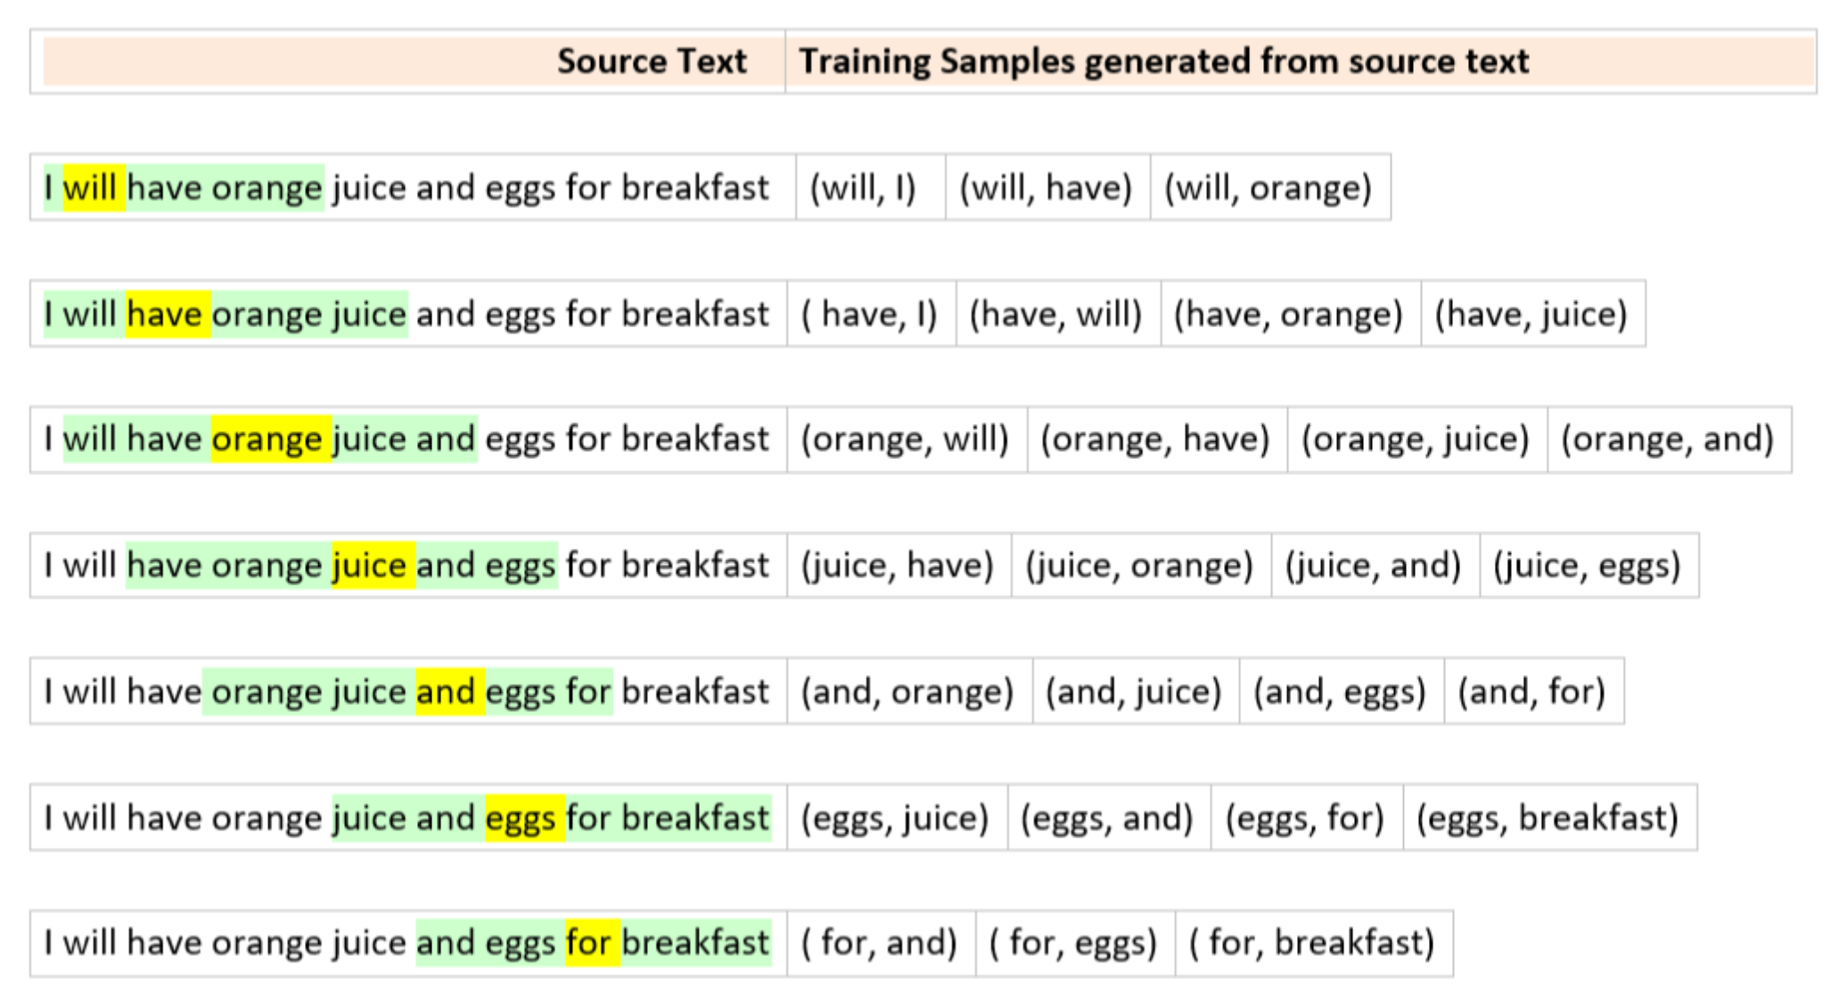
Skip-gram

Slide 31
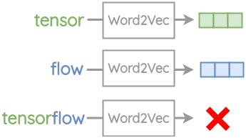
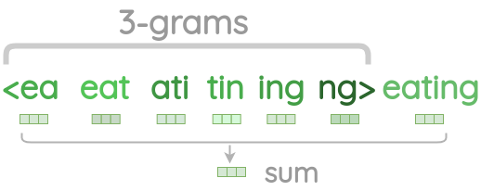
FastText – n-grams
https://amitness.com/2020/06/fasttext-embeddings/

Slide 32
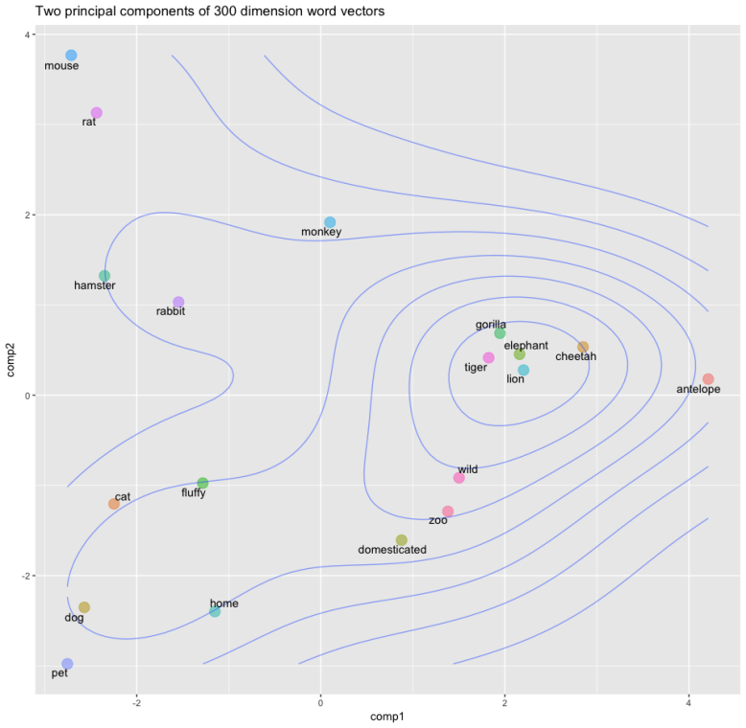
Example

Slide 33
In practice
https://spacy.io/
https://fasttext.cc/
https://radimrehurek.com/gensim/
https://github.com/google-research/bert

Slide 34
THE END

